Slide 1
Word Order in News Texts
Corpus Crew (Group 10)
Assylbek Tleules – 12432843
Emily Jacob – 12143768
Luka Santek – 12332270
Tehseen Ali Tahir - 12433763

Slide 2
Research Question
“What is the distribution of word order types (SVO, SOV, VSO, etc.) in each language?”
“Do flexible-order languages (e.g., Spanish, Greek) show an increased preference for SVO
after 2022 compared to before?”

Slide 3
Data Collection
Source: Leipzig News Corpora
Languages: English, Russian, German
Number of sentences/year: 10,000
English: 2018, 2019, 2020, 2023, 2024
German: 2019, 2022, 2023, 2024
Russian: 2013, 2019, 2020, 2022, 2024

Slide 4
Preprocessing Pipeline
1. Data Merge/Cleaning
  Merge datasets and metadata
  Remove URLs, HTML tags, extra whitespace
  Strip quotes and normalize punctuation
2. Filtering
  Remove duplicate sentences
  Remove sentences < 8 tokens
3. Metadata Handling
  Preserve: year, source, date, language
  Label Pre/Post GPT based on date metadata
4. Output
  Clean TSVs per language: language_year.tsv
After pre-processing, we were left with 154k sentences ready for Stanza annotation!

Slide 5
Lingustic Annotation
Stanza models loaded per language: en, de, ru
Processed with:
  Tokenization → split sentences into words/punctuation
  Lemmatization → normalize words to base form
  POS tagging → identify nouns, verbs, etc.
  Dependency parsing → find grammatical relationships (subject → verb → object)
Output
  Each sentence annotated in CoNLL-U format
  Metadata preserved: year, period, sentence ID, sentence as comments
  Ready for Ground Truth and Rule-based/ML classifiers

Slide 6
Ground Truths using Stanza
3 Step Algorithm:
  1. Find root verb - Looks for: deprel='root' and POS='VERB'/'AUX’
  2. Extract S & O connected to root verb:
    Subject: deprel='nsubj', head=root_verb_id
    Object: deprel='obj', head=root_verb_id
    Constraint: must point to main verb
  3. Compare positions -> classify order
    SVO, SOV, VSO, VOS, OSV, OVS
    Partial orders: SV_only, VO_only, SO_only
    If missing -> INCOMPLETE
    Limitations:
    Parser errors - 15-25% of labels may have parser errors
    Main clause only - Ignores subordinate clauses
    Coordination - Takes first subject/object only

Slide 7
Stanza Annotation Evaluation
Evaluation of Stanza Annotations
  Manually annotated Subject, Verb, Object order of 20 sentences from the test set to evaluate Stanza ground truth.
  Metric: Exact word order match
  Overall Accuracy: 55% (33/60 correct)
  Per language accuracy:
    Russian – 70% (14/20 correct)
    English – 65% (13/20 correct)
    German – 30% (6/20 correct)
  Implies language-specific extraction issues.

Slide 8
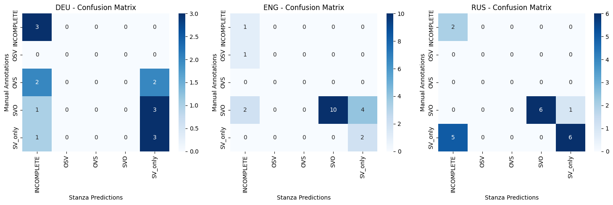
Confusion Matrix: Per Language

Slide 9
Error Analysis: Insights
Russian:
  Stanza dependencies are reliable. -> mostly correct SVO.SOV classifications.
English:
  Failed to extract objects correctly -> SVO is sometimes misclassified as SV-only or VO-only.
German:
  Extraction fails to differentiate auxiliary verb and lexical verb

Slide 10
Rule-Based Baseline: Simple Heuristic
4 Step Algorithm:
  Find first verb - scan left to right, stop at first VERB or AUX
  Look before the verb - are there any nouns/pronouns?
  Look after the verb - are there any nouns/pronouns?
  Classify:
    Nouns both before AND after -> must be SVO!
    Only before -> SV_only
    Only after -> VO_only
    Neither -> INCOMPLETE
The problem: It doesn't understand which nouns go with which verbs. It just assumes positional proximity = relationship.

Slide 11
Rule-Based Baseline: POS pattern
3 Step Algorithm:
1. Collect all positions
  Make a list of all nouns with their positions: [(N, 2), (N, 5), (N, 8)]
  Make a list of all verbs with their positions: [(V, 3), (V, 10)] Look after the verb - are there any nouns/pronouns?
2. Pick candidates:
    Subject = first noun
    Verb = first verb
    Object = second noun
    If we dont have at least 2 nouns and 1 verb -> INCOMPLETE
3. Compare positions and classify:
    If N1 < V < N2: SVO (noun, verb, noun)
    If N1 < N2 < V: SOV (noun, noun, verb)
    If V < N1 < N2: VSO (verb, noun, noun)
It still doesn't understand GRAMMAR. It just looks at word category (noun vs verb) and position.

Slide 12
ML Classifier for Word Order
Stanza as a ground truth
Algorithms: SVM, Naïve Bayes, Logistic Regression
Feature extractors: BoW, TF-IDF
Workflow:
  Perform cross-validation and hyperparameter tuning on the training set using GridSearchCV
  Select the best hyperparameter configuration for each (model, feature extractor) combination based on weighted F1-score.
  Evaluate the best configuration of each combination on a held-out validation set.
  Compare models using validation metrics (F1, balanced accuracy, precision, recall) and select the overall best-performing model.
  Leave the test set unseen for final comparison with rule-based models
  Final best model was chosen based on in-depth analysis and evaluation on test set
  Evaluation was done separately for binary classification and multiclass classification task

Slide 13
Evaluation: ML Classifier
Evaluation Setup:
  Train /validation split
  GridSearchCV with cross-validation
Metrics used:
  Accuracy
  Balanced Accuracy
  Macro F1
Why balanced metrics?
  Strong class imbalance (SVO dominates)
  Accuracy alone would overestimate performance
BEST Multiclass ML MODEL:
Logistic Regression -> Bal. Accuracy of 46.1 %

Slide 14
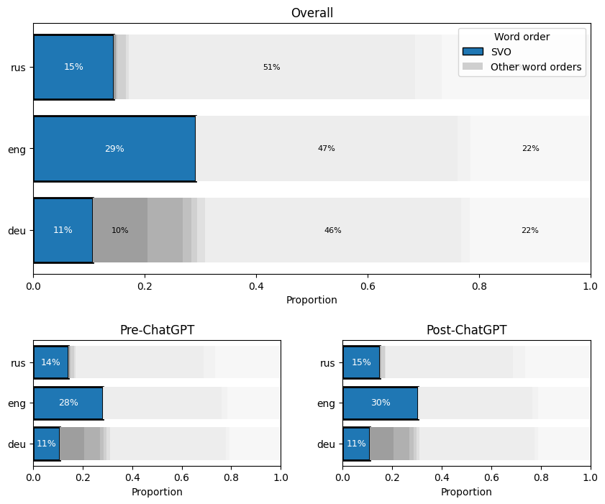
Insights

Slide 15
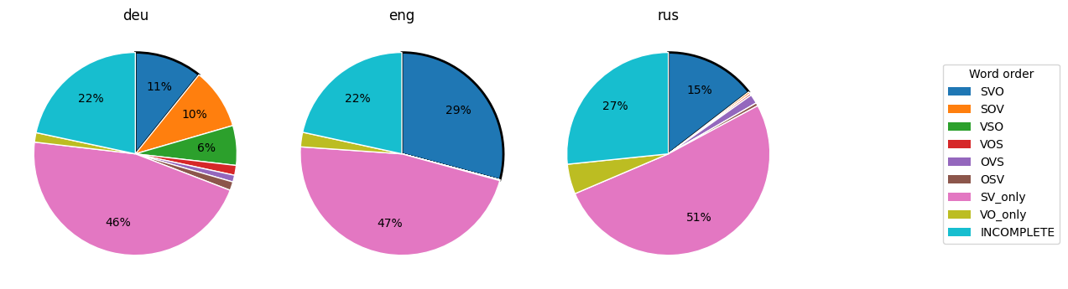
Insights

Slide 16
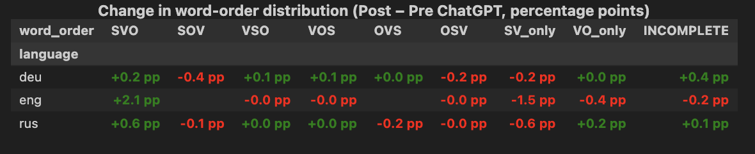
Insights

